Slide 1
ClinCluster: Aggregating Disease Terms in ClinVar
NCBI’s ML/AI Codeathon
Feb 26 - Mar 1, 2024

Slide 2
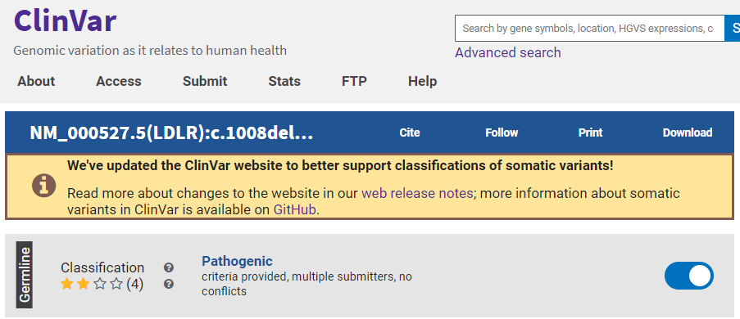
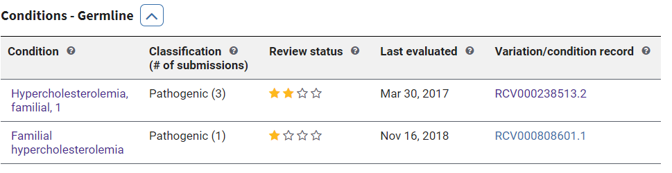
ClinVar
Hypercholesterolemia due to variants in the gene LDLR
Any inherited type of hypercholesterolemia

Slide 3
Problem statement: Diseases in ClinVar are very granular and result in many variant-disease records.
Can we use an ML/AI approach to aggregate disease terms in ClinVar to reduce the number of variant-disease records?

Slide 4
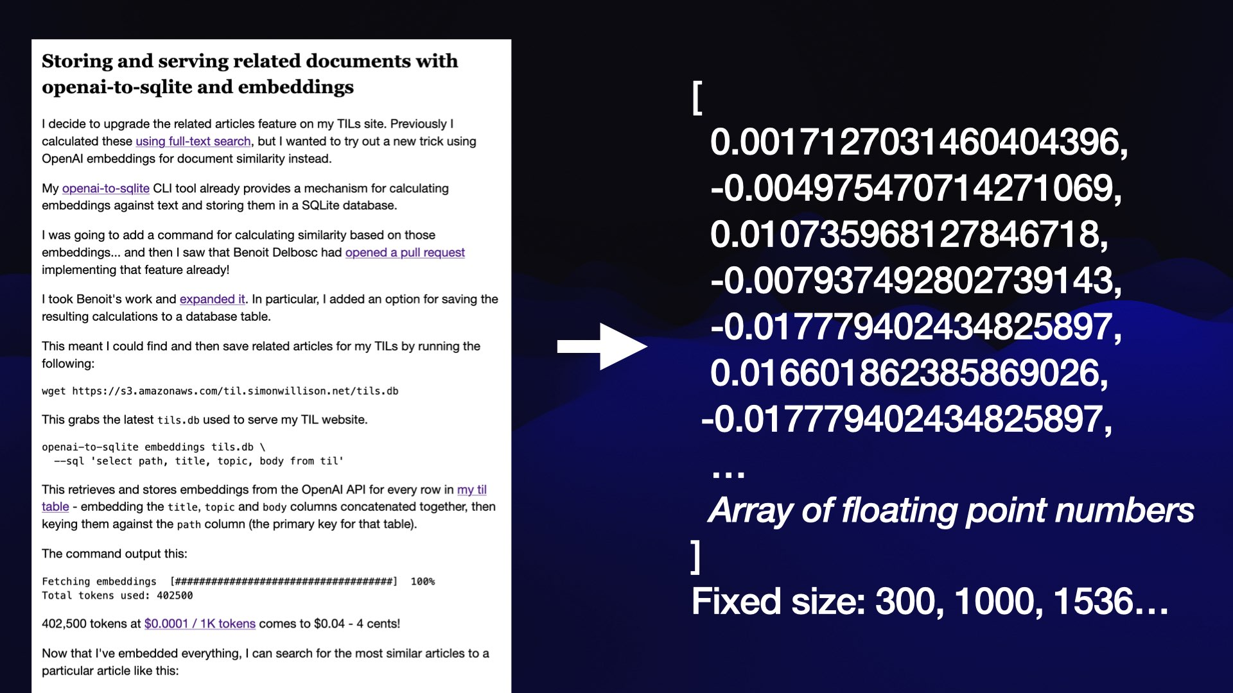
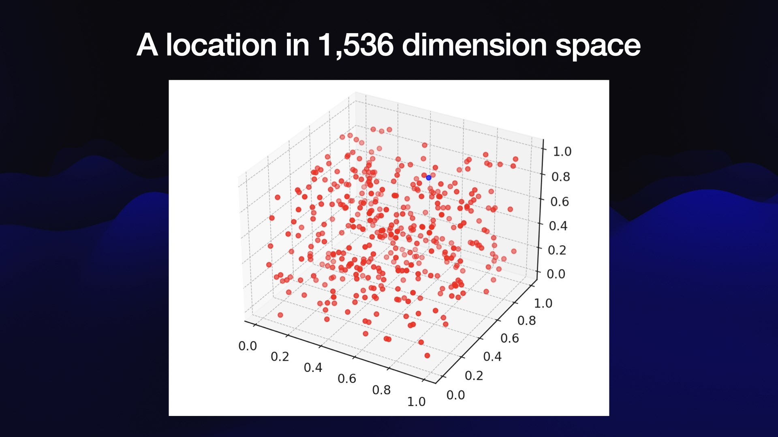
ClinCluster: Use LLM to aggregate these similar disease terms
Embeddings in LLM: take a piece of content and turn that piece of content into an array of floating point numbers.
Same length, no matter how long the content is
Workflow
Feed the disease names to LLM
LLM gives a embedding (a array of floating point numbers) for each name
Use the embeddings to cluster the disease terms
Images from https://simonwillison.net/2023/Oct/23/embeddings/
Notes:
More info in embedding
https://simonwillison.net/2023/Oct/23/embeddings/

Slide 5
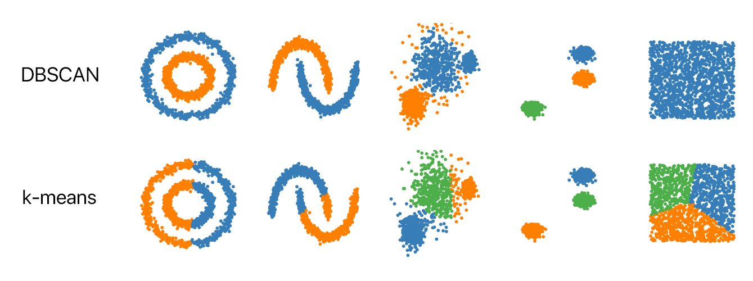
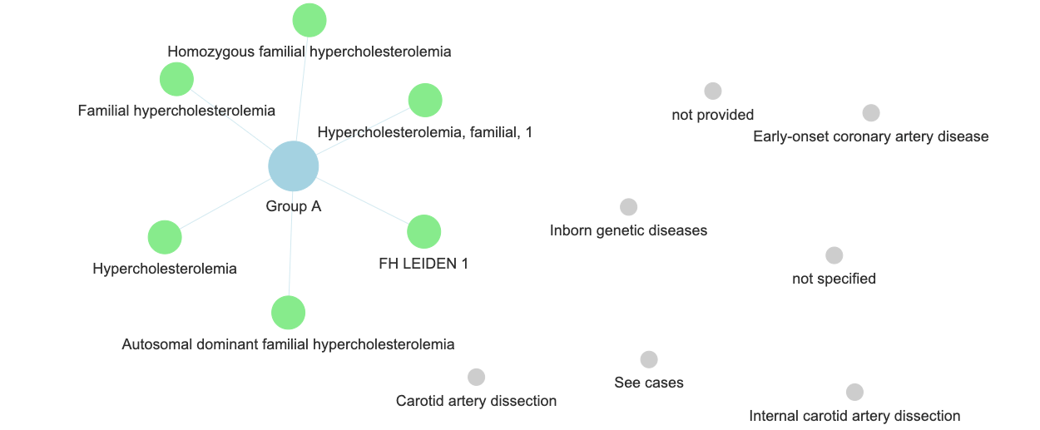
DBSCAN: cluster the disease names
Result:
Image from https://github.com/NSHipster/DBSCAN
We forked and modified llm-cluster package https://github.com/simonw/llm-cluster
We change the k-means clustering algorithms to unsupervised DBSCAN algorithm for clustering the disease names.
Notes:
More info on DBSCAN:
DBSCAN stands for Density-Based Spatial Clustering of Applications with Noise. It is a popular clustering algorithm used in machine learning and data mining to group points in a dataset that are closely packed together, based on their distance to other points.
https://medium.com/mlearning-ai/dbscan-demystified-understanding-how-this-parameter-free-algorithm-works-89e03d7d7ab#:~:text=DBSCAN%20stands%20for%20Density%2DBased,their%20distance%20to%20other%20points.

Slide 6
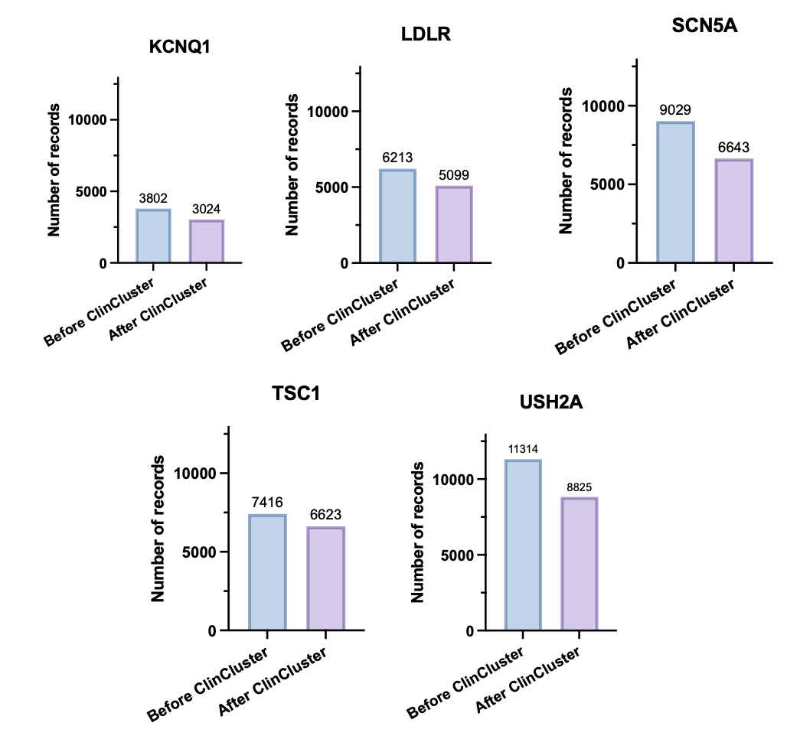
ClinCluster: Performance metric
Significant reduction in the total number of RCV records
Disease term clustering is
done by LLM clustering algorithm.

Slide 7
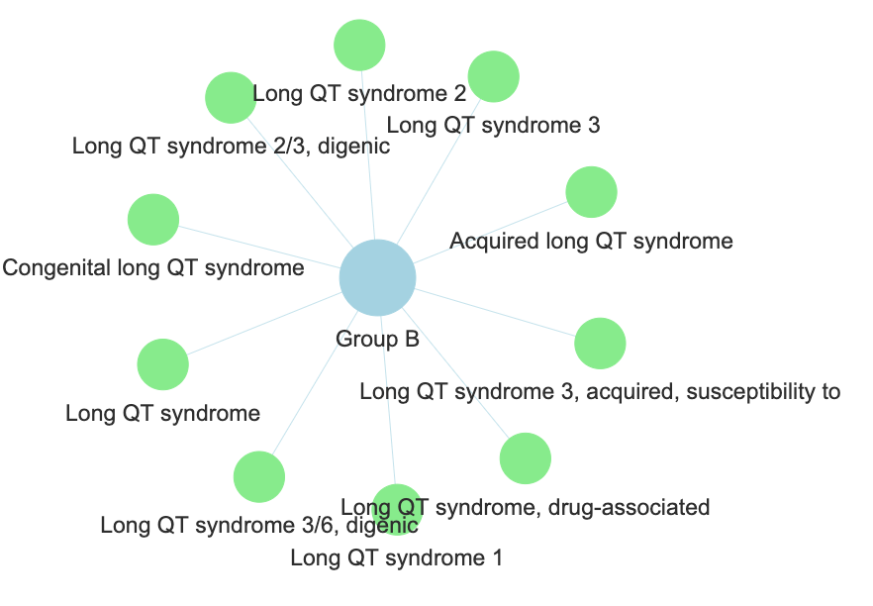
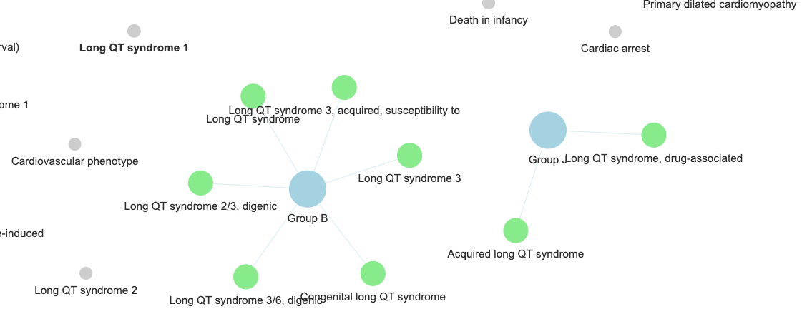
However, LLM clustering is not perfect…
Disease clusters for SCN5A gene
LLM clustering
Expert curated
Circled diseases are caused by other underlying conditions
Rare conditions
State-of-art LLM might help

Slide 8
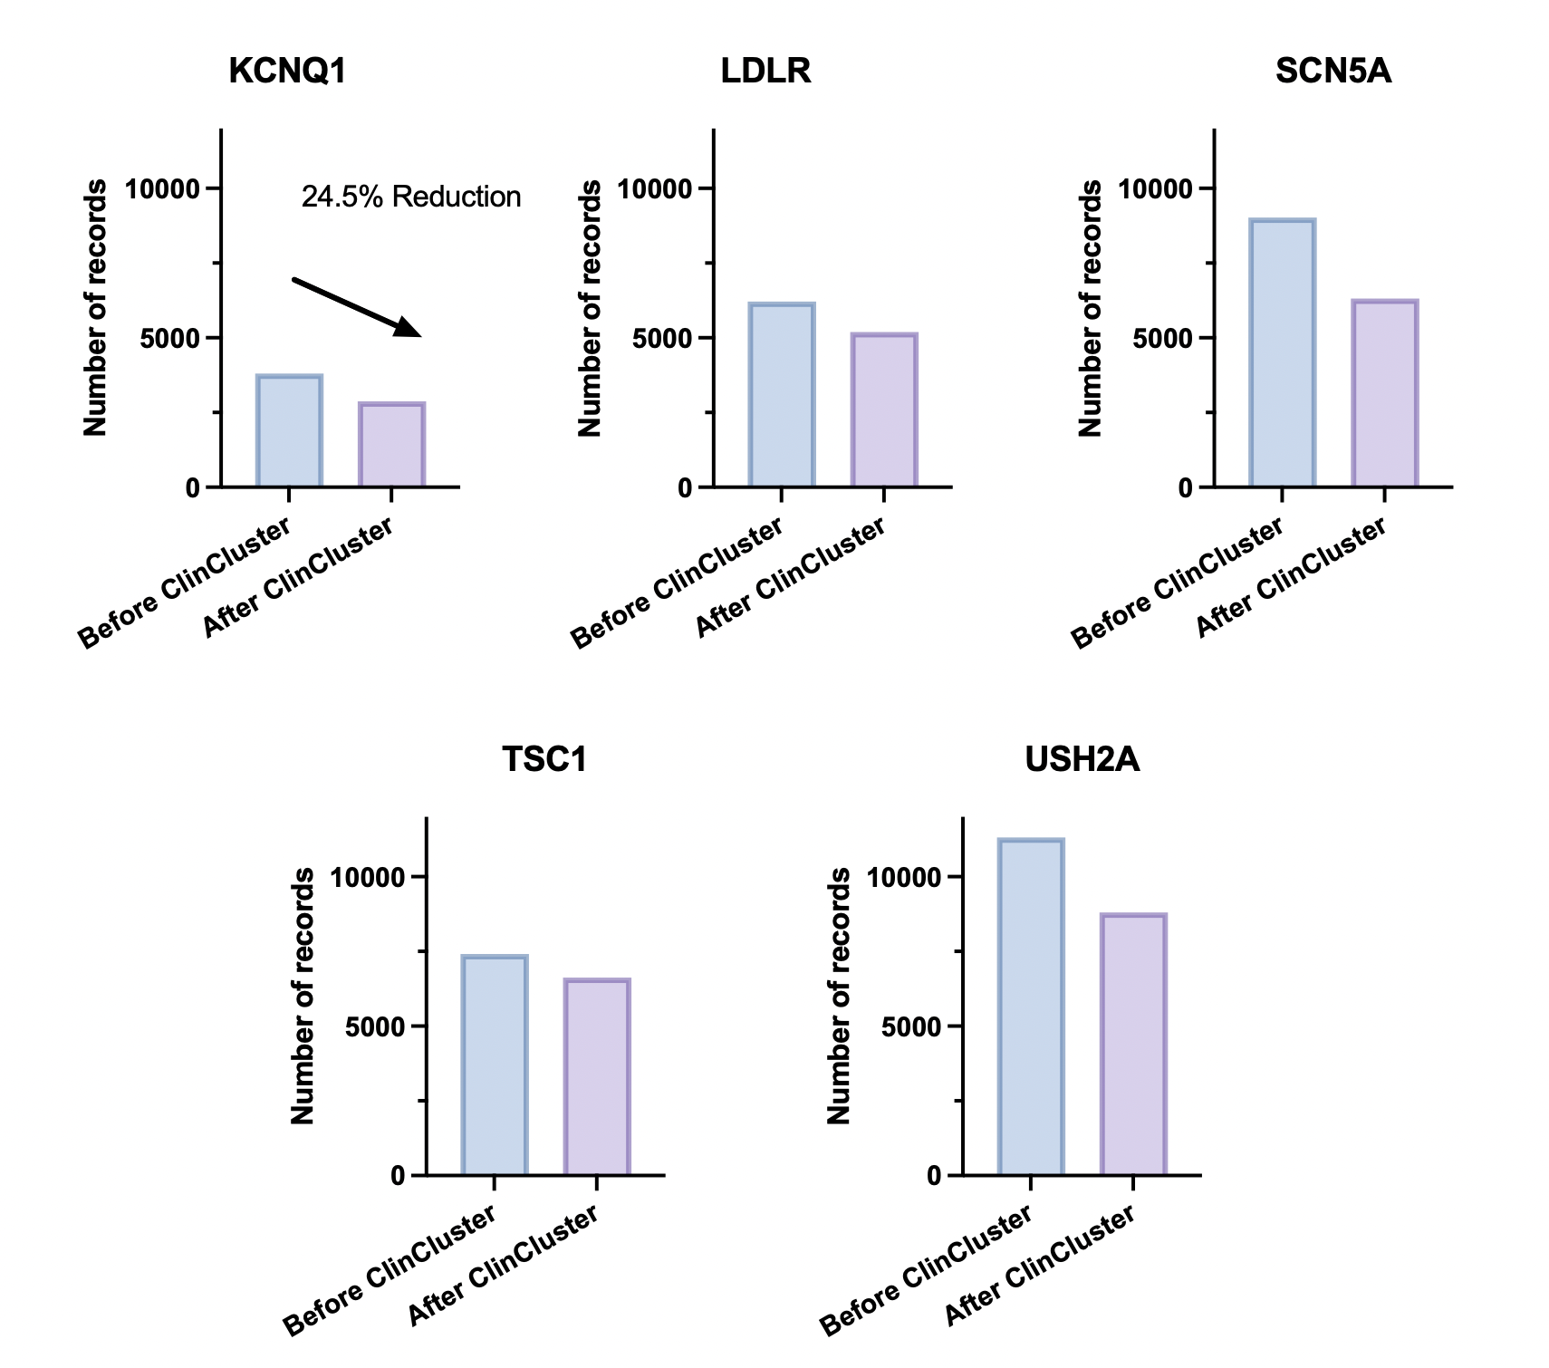
ClinCluster: Performance metric
Significant reduction in the total number of RCV records
Disease term clustering is
augmented by human expert

Slide 9
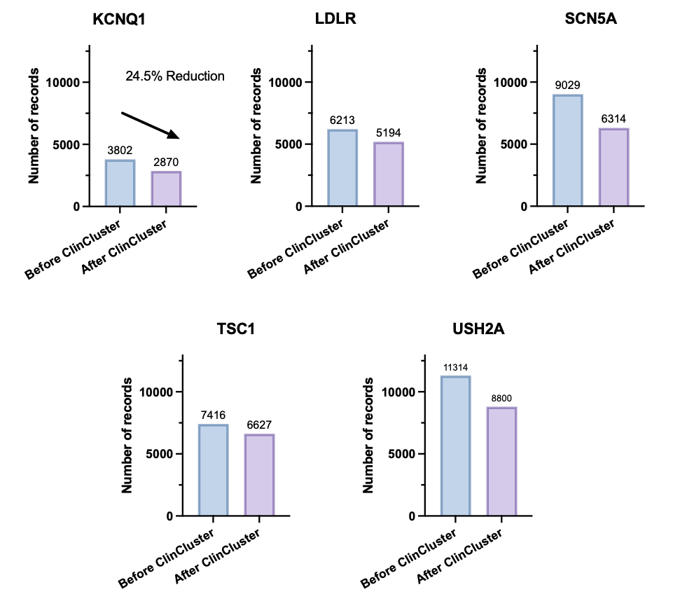
ClinCluster: Performance metric
Disease term clustering is
augmented by human expert after LLM clustering.
Disease term clustering is
done by LLM clustering algorithm.

Slide 10
ClinCluster: Performance metric
AI is not perfect but still amazing; human experts are crucial!

Slide 11


Reproducible implementation

Slide 12
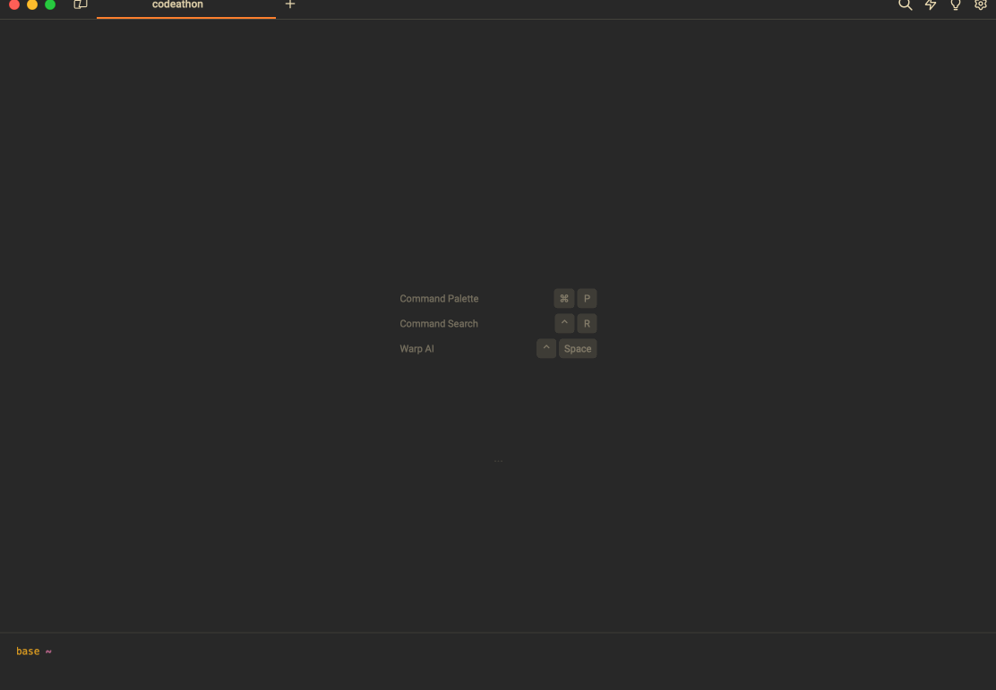

Slide 13
Acknowledgements
Lauren Edgar, NIH/NHGRI
Benjamin Kesler, Vanderbilt University
Nicholas Minor, University of Wisconsin
Michael Muchow, Unaffiliated
Rebecca Orris, NIH/NCBI
Wengang Zhang, NIH/NCI
Guangfeng Song, NIH/NCBI (Co-Team Leader)
Melissa Landrum, NIH/NCBI (Co-Team Leader)

Slide 14
Dark title slide option

Slide 15
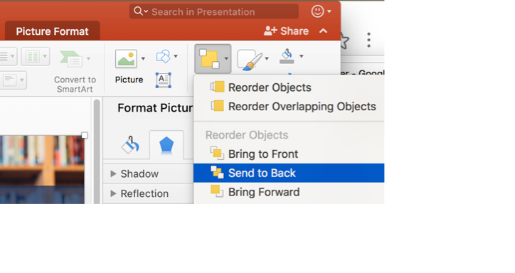
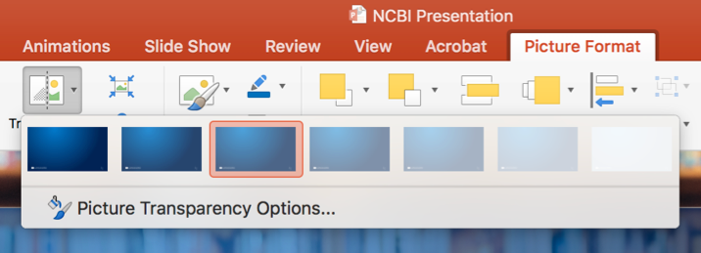
Create a photo background like in the previous slide
Insert a background photo in Slide #2.
In the Home tab, go to the Arrange dropdown, select Send to Back.
Select the books background photo and delete it.
Adjust the transparency of the blue rectangle, select the rectangle, go to the Picture Format tab and select appropriate Transparency.

Slide 16
Recommendations for presentation slides
Do not include a lot of text in your presentation slides. Only include what is absolutely necessary to get your point across.
Your audience will concentrate to much on reading the slides an not listen to what you have to say.
If the audience needs to retain a lot of information, give out handouts or a web link at the end of the presentation.

Slide 17
One idea per slide.
Consider your slides as an outline of your talk.

Slide 18
One of the key facts about working memory is that it has a very limited capacity. The Principle of Limited Capacity states that people have a limited capacity to retain and to process information and will not understand a message if too much information must be retained or processed.
Baddeley A. D. (2007). Working Memory, Thought and Action. Oxford:
Oxford University Press

Slide 19
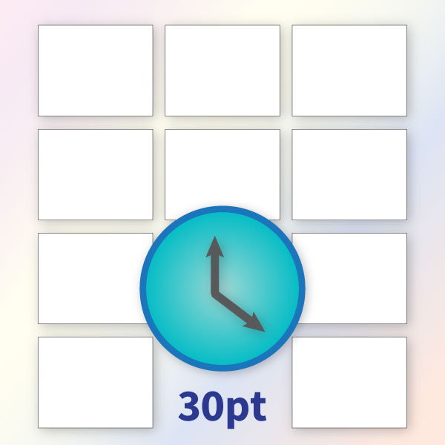
10/20/30 Presentation Rule
10 slides in total
20 minutes
30pt minimum font size
If your content does not fit in the slide at 30pt font size, you may have too much content on the slide.

Slide 20
Do not read your slides.
Your audience can read by themselves and makes your talk boring. They will either read your slides or listen to you.
They won’t do both.

Slide 21
Use graphics and charts.
The more visual the input becomes, the more likely it is to be recognized and recalled.

Slide 22

Photos are good but don’t get carried away with too many on one slide. It’s a presentation, not a photo album.
NCBI can get photos from https://www.istockphoto.com. Email trawick@nih.gov if you want to get a photo from this site.

Slide 23
Retention of information in presentations

Slide 24
What annoys you about PP presentations?
603 respondents

Slide 25
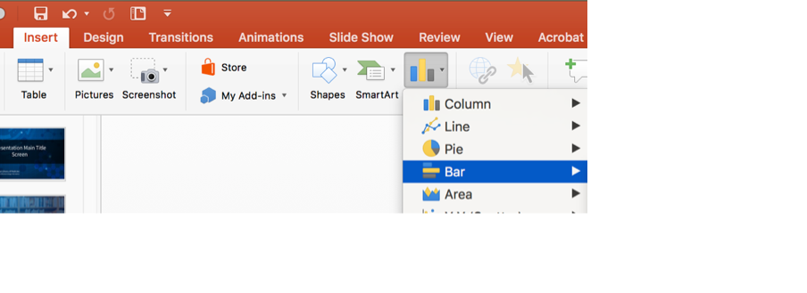
How to create a chart
Insert a new slide in your presentation.
In the Insert tab, select Chart and pick the type of chart you would like to use.
An Excel spreadsheet will open up where you can enter your data.

Slide 26
Color Palette
These colors can be found in in the Theme Colors menu.
Text Color
On light backgrounds, text should be black.
On dark backgrounds, text should be white.

Slide 27


NCBI double helix logo
We are not using this symbol as an NCBI logo anymore. The only logo that should be present in NCBI materials is the NIH logo. We recognize that this is a recognizable symbol for our organization. If you wish to use this symbol for decorative purposes in your presentation, here is a dark and light version.

Slide 28
Acknowledgements

Slide 29
Acknowledgements 2

